Slide 1

A New Approach in Diagnostics and Therapy of ADHD
Dr. Ralph meyers
sozialpsychiatrisches centrum dr.meyers dorsten , 2018

Slide 2
Opatus CPTA
The Opatus CPTA, developed by Opatus (www.opatus.se) is a mobile test measuring inattention, impulsivity, motor activity and reaction time used for diagnostic procedures in ADHD and in follow up diagnostics during therapy. It can also be used for therapy control in for example Parkinson`s disease, Mind fatigue or dementia.
There are 5 different versions for different groups of age:
- toddler 3-6 years - adult 18-60 years
- child 6-12 years - senior >60 years
- adolescent 12-18 years
Notes:
Opatus CPTA
CPTA = CPT + A = Continuous Performance Test + Activity = Standard Attention test as used by psychologist since the 50’s + Objective assessment of motor activity

Slide 3
  The tool is currently under evaluation in several European countries.
  Scientific projects may be eligible for free use, contact Opatus
  Runs on iPod, iPhone and iPad. Free download from App Store.
  A subset of the results is available on the device immediately after test.
  A comprehensive graphic report is available for registered users via a Web portal. Pay-per-use, no fixed fees. Invoiced monthly.
  The test is mobile and can be used in realistic environments
  The patient needs a minimum of management during the test. This opens for simultaneously testing of multiple patients (requires iPods).
  This saves time and cost of personnel.
  Some patients will be able to have their test done at home and can present it later to their consultant.

Slide 7
Why is this kind of test an important part for the clinician?
We will be able to acchieve a more accurate diagnosis
We will be able to adjust our treatment better
We will get better long term outcomes for our patients, meaning to reach even the outgrowing of ADHD with good clinical practice

Slide 8
Amphetaminsulfat Recipe 2%

Slide 9
LDX „fine tuning“ 1

Slide 10
LDX „fine tuning“ 2

Slide 11
MPH 1

Slide 12
MPH 2

Slide 13
Imipramine hydrochloride 1

Slide 14
Imipramine hydrochloride 2

Slide 15
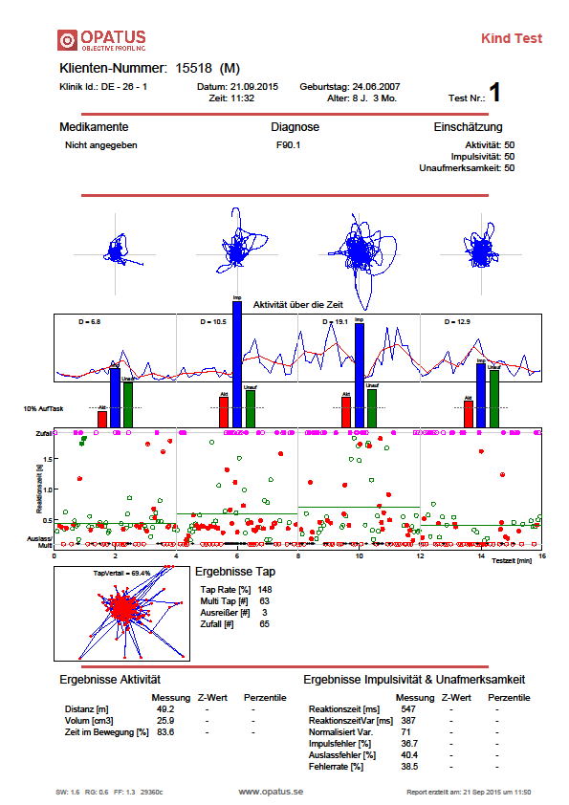
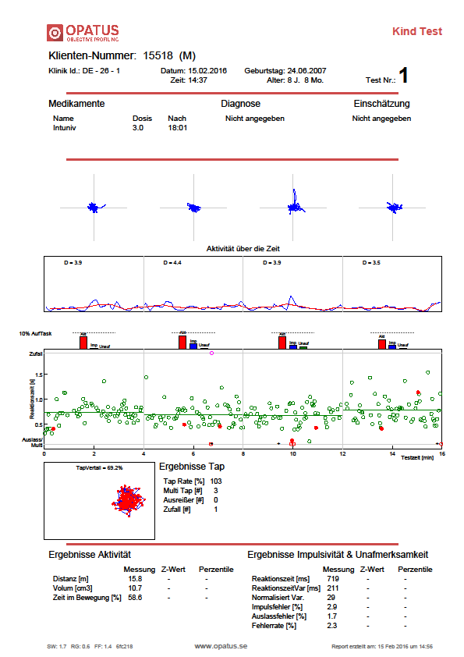
GXR 1

Slide 16
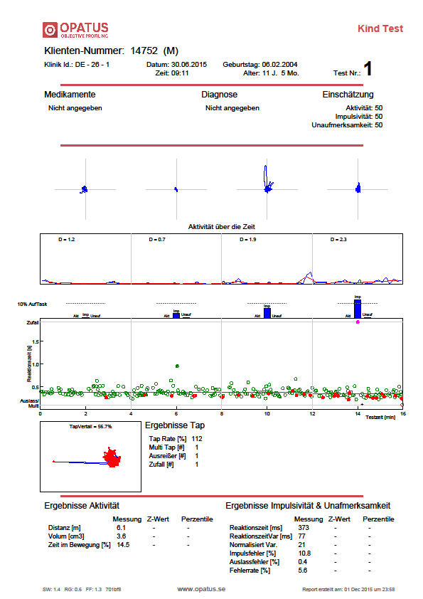
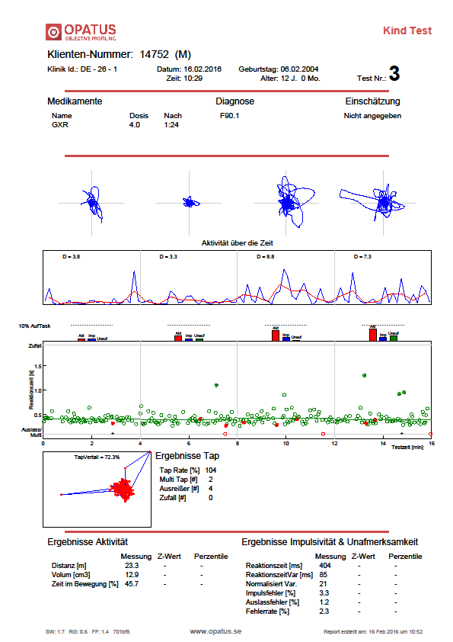
GXR 2

Slide 17
Thanks for your attention
Dr. med. Ralph Meyers
Consultant for Child and Adolescent Psychiatry, Psychotherapy
Member of TGD, ZGD,BKJPP,DGKJP
Member of Ethics Commission of the Medical Association – Westfalen-Lippe and University Muenster
Leading Investigator, Consultant for KVWL (PharmPro)

